Slide 1

Wireless Guitar

Slide 2
Index
5
Demo
1
Motivation
2
Sensor
6
Contribute
3
How to USE?
7
Expectation
4
How it Works
8
Review

Slide 3
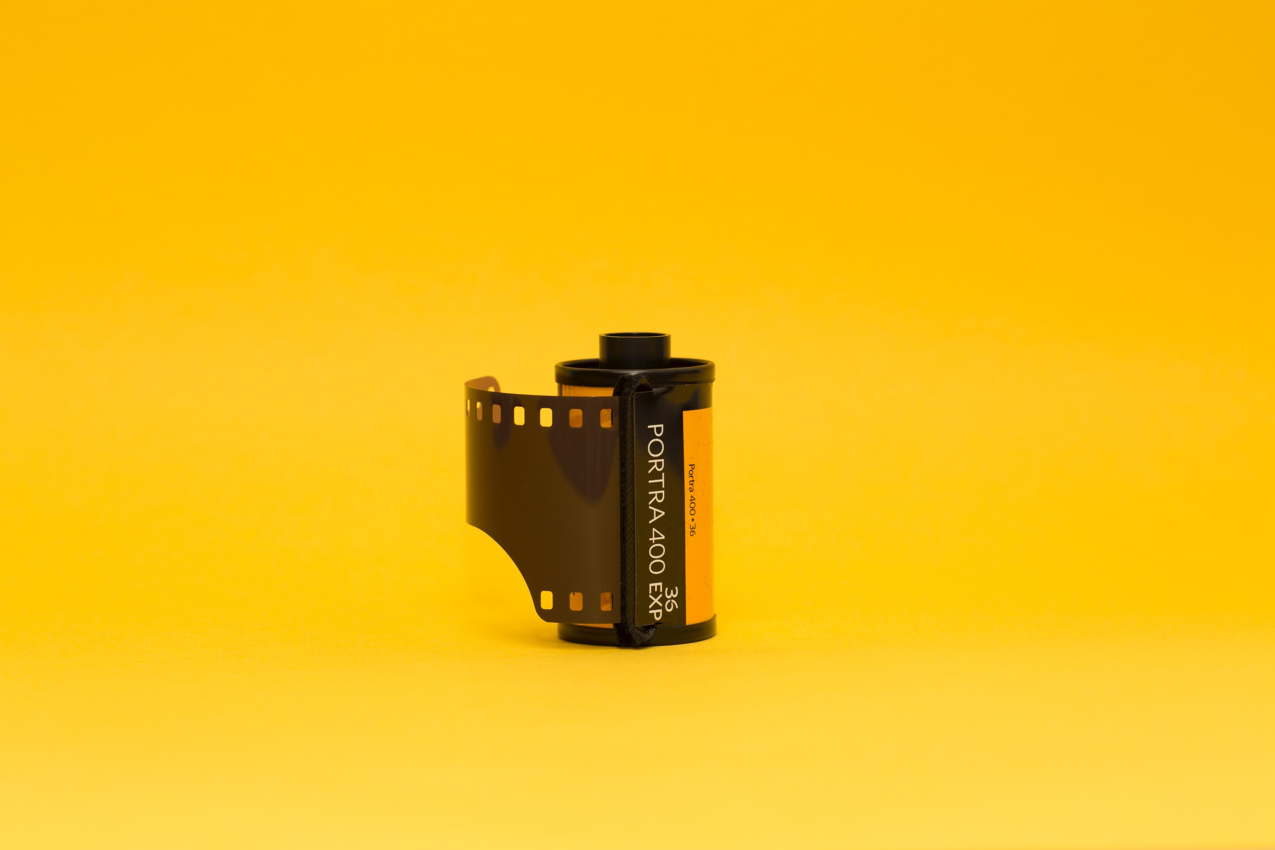
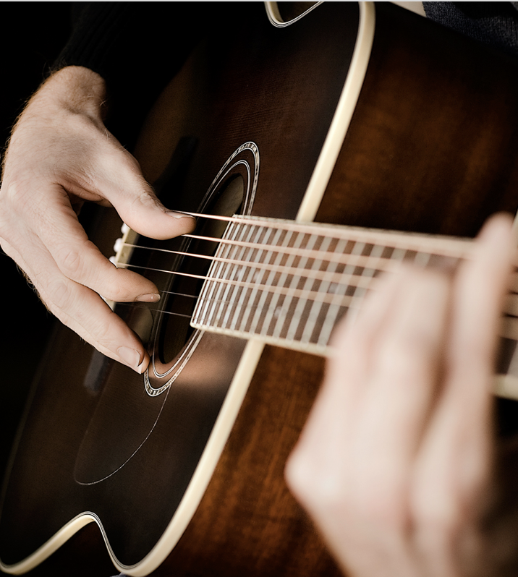
“
Motivation”
Hard to memorize codes.
Need lots of practice.
Hard to make clean sounds to beginner.

Slide 4

So we think...

Slide 5
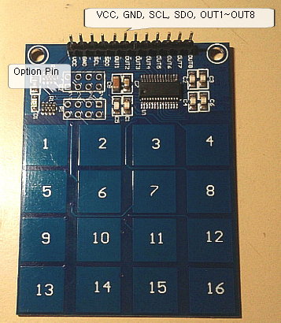
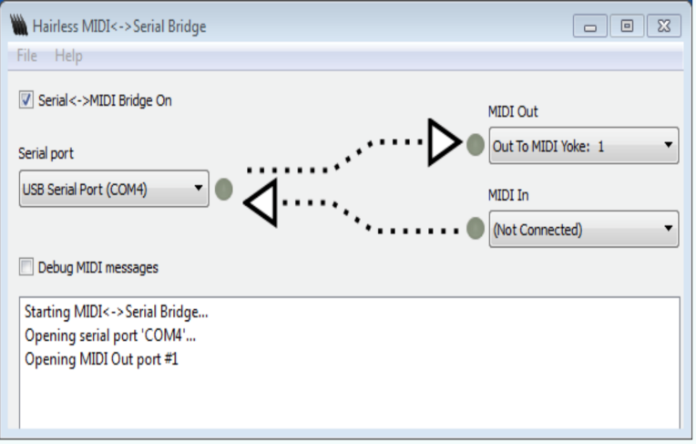
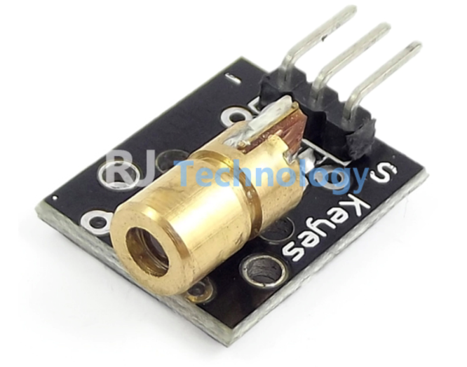
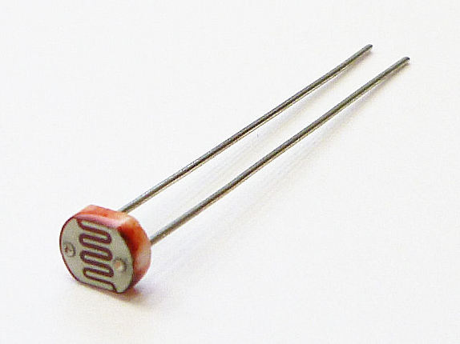
Sensor
1. Laser Sensor:
For each guitar line
Total: 6 sensors
2. Touch Sensor Keypad:
Each keypad have another Chord
Total: 1~2 sensors
3. Speaker
Using Midi-Serial bridge
Various instruments
4. Light Sensor.
Get Lasers light power

Slide 6
How to USE?
Connect with computer and turn on midi serial bridge
Touch the button that code you want.
Pass the laser!!
1
2
3

Slide 7


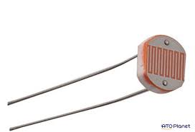


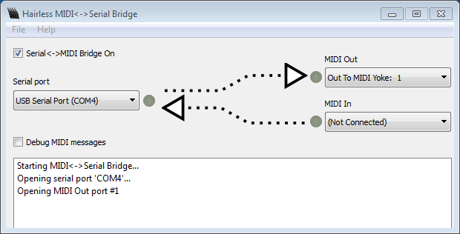
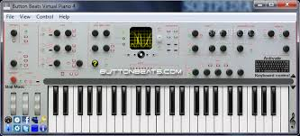
How it Works?

Slide 8
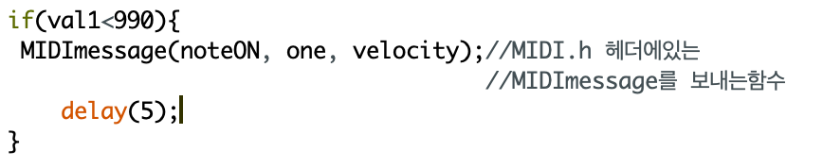
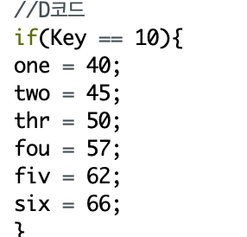
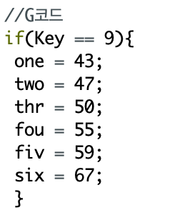
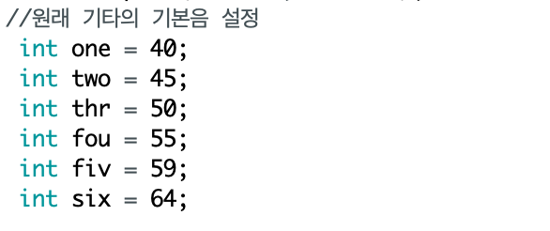
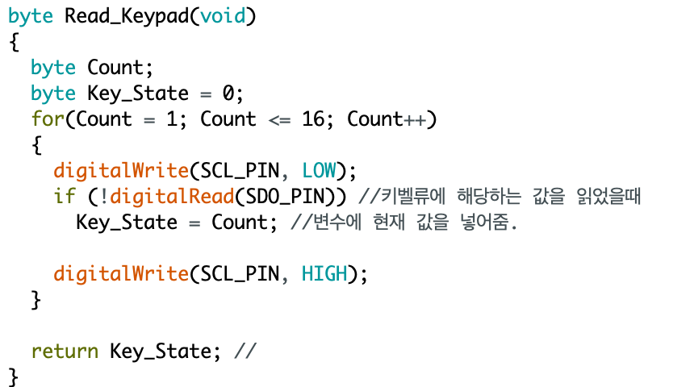
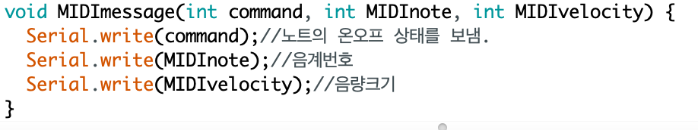
Code

Slide 9
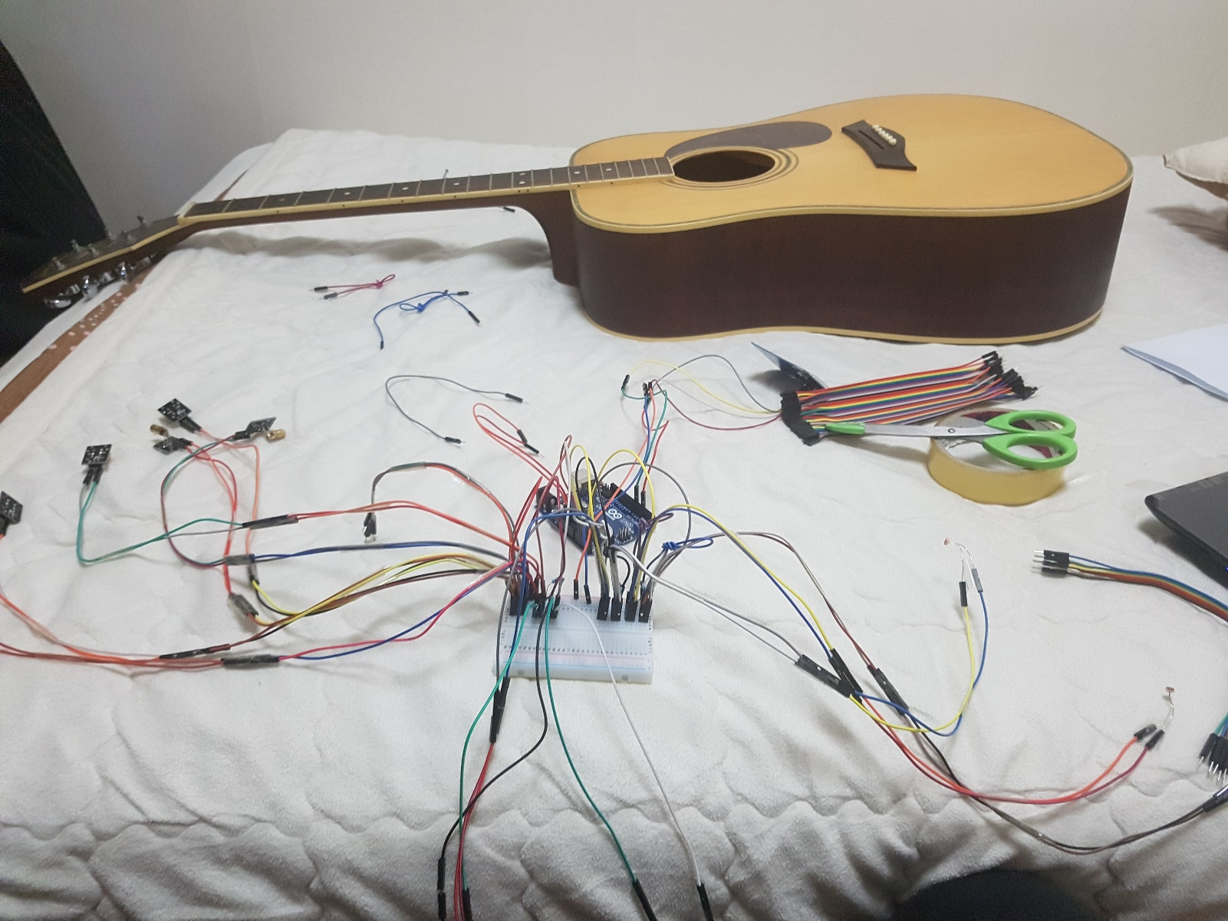
Production process

Slide 10
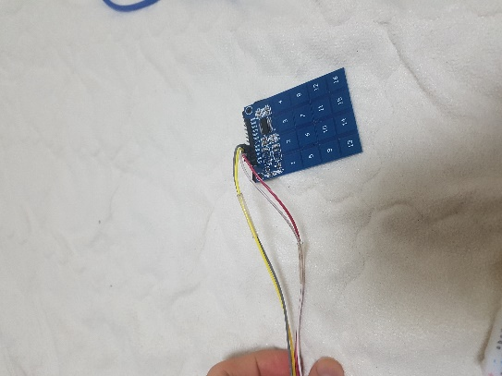
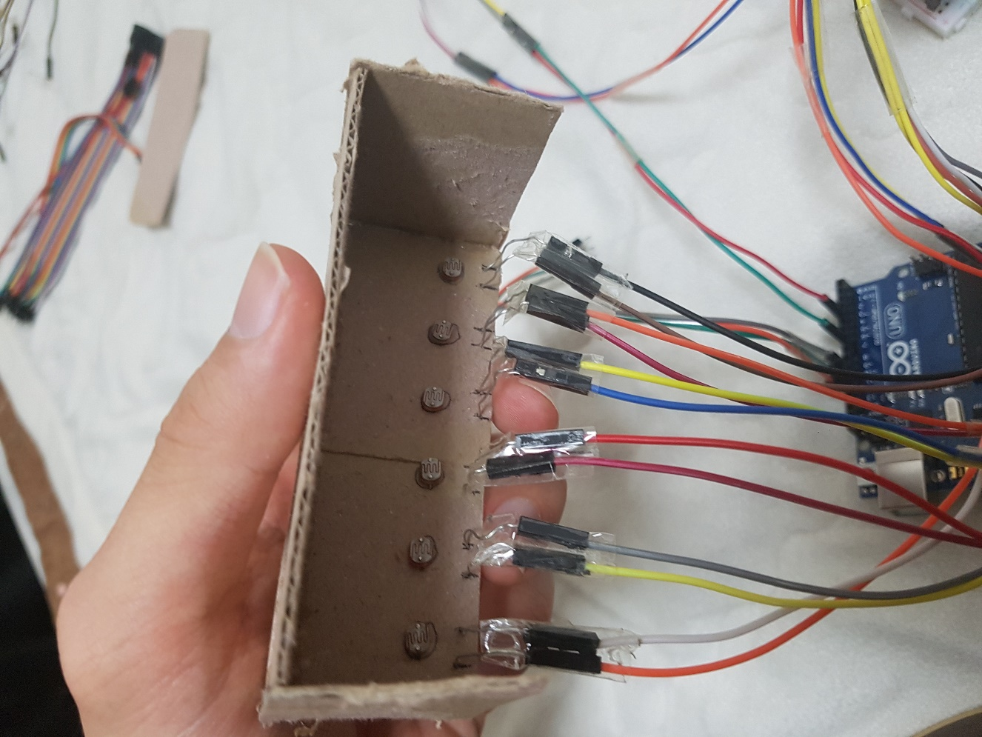
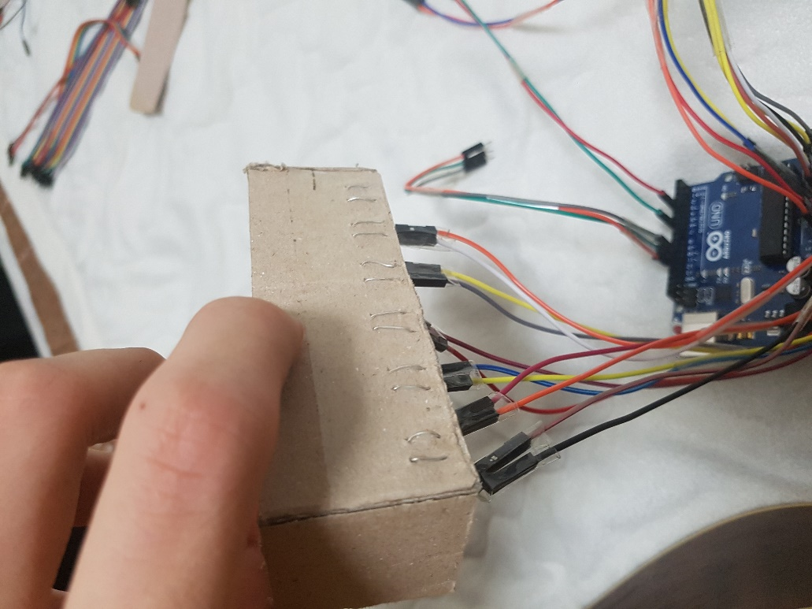
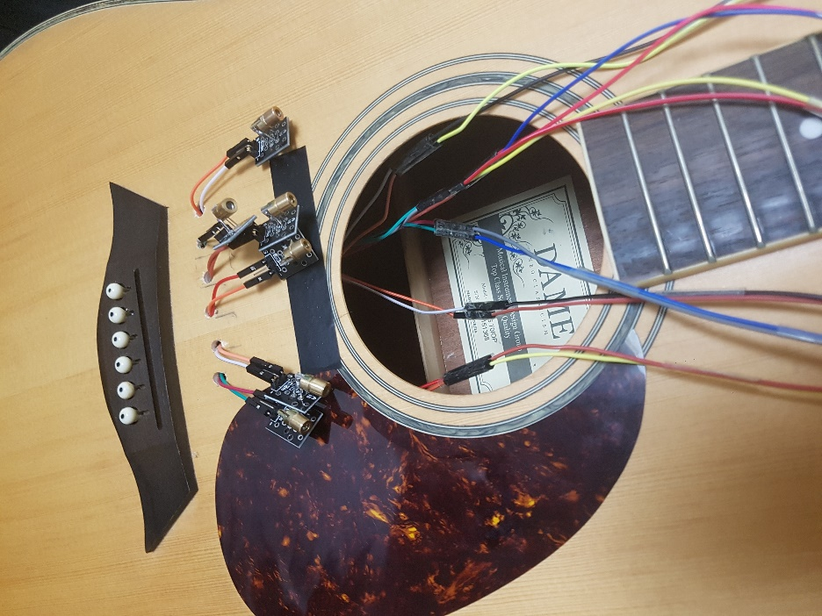
Production process

Slide 11
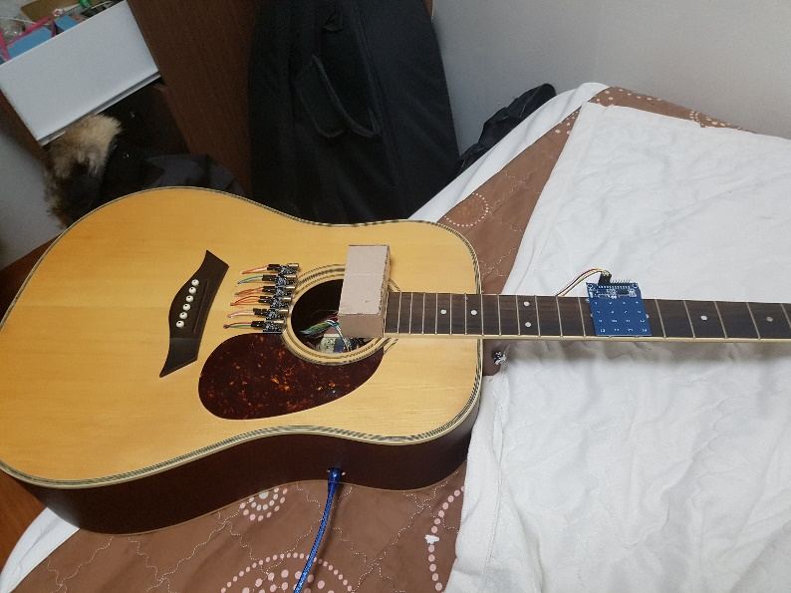
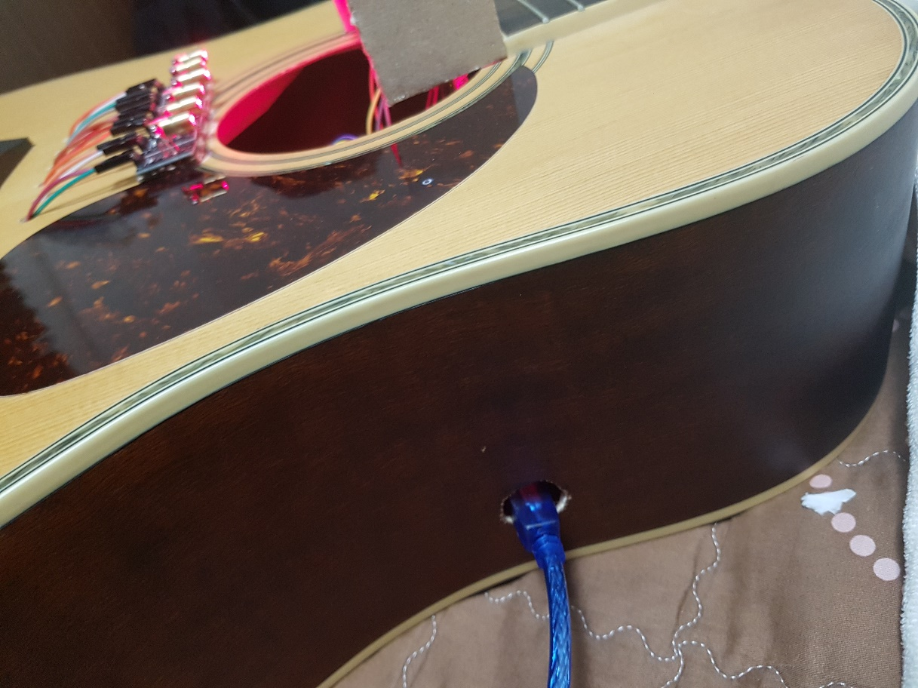
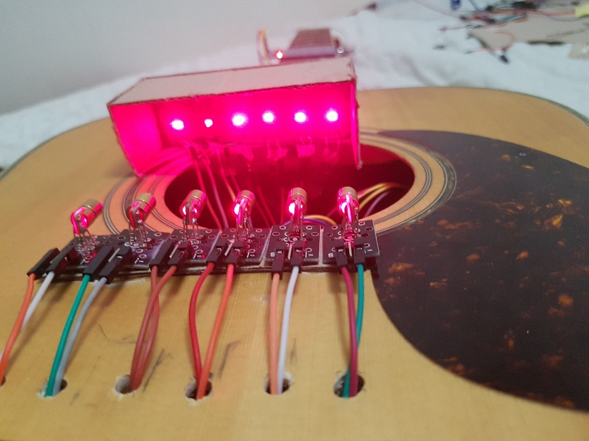
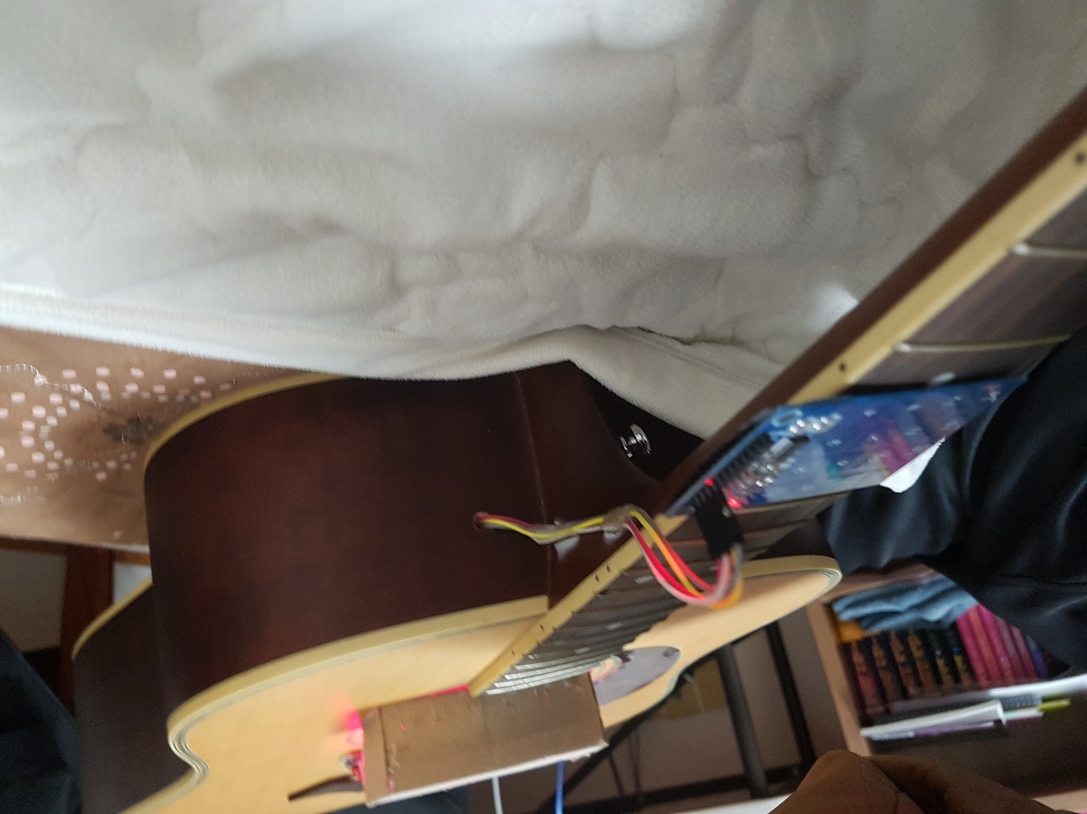
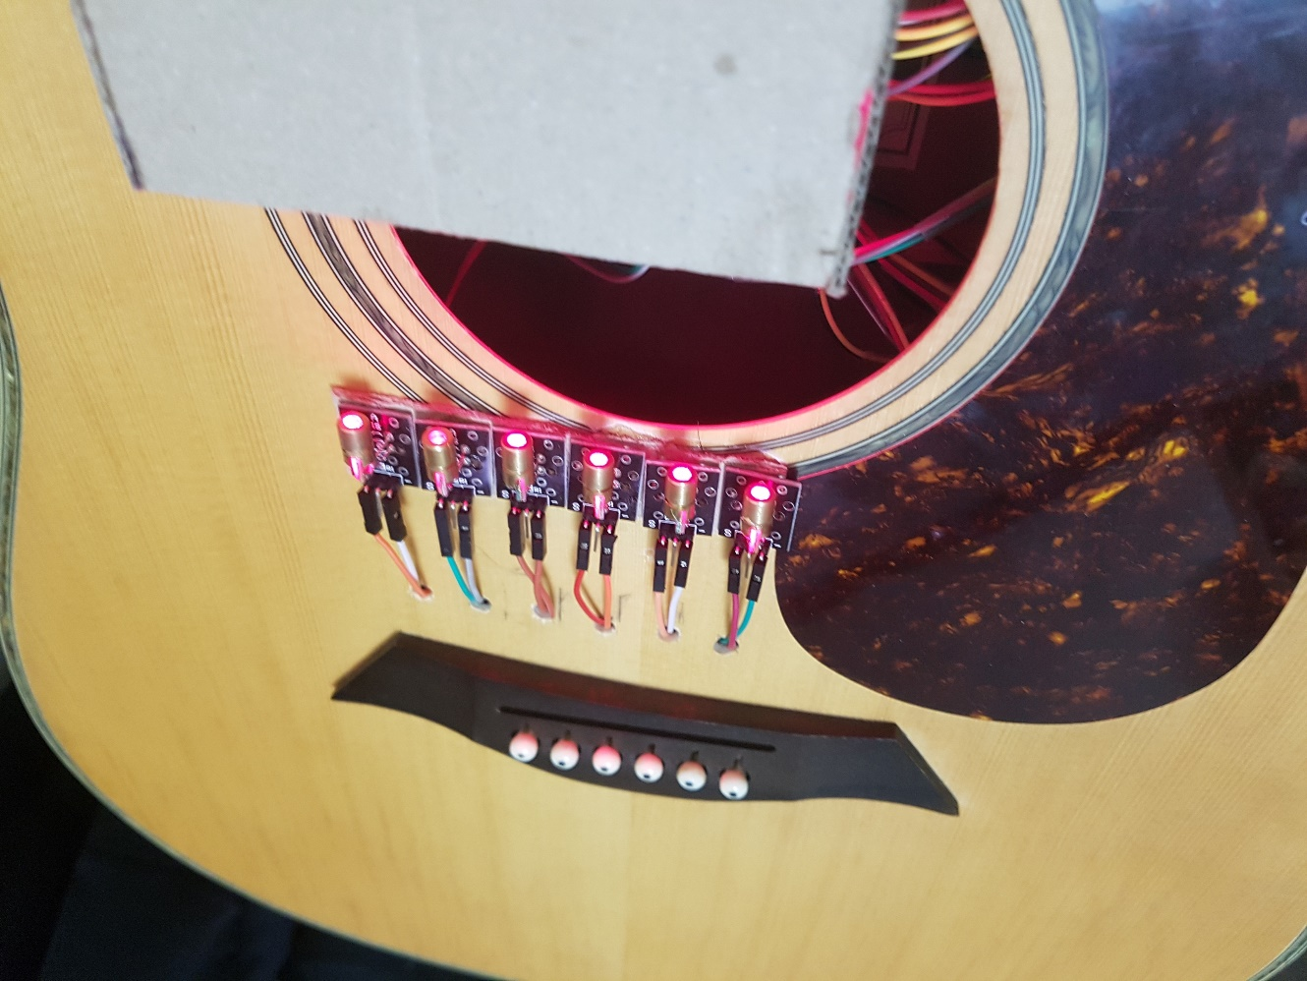
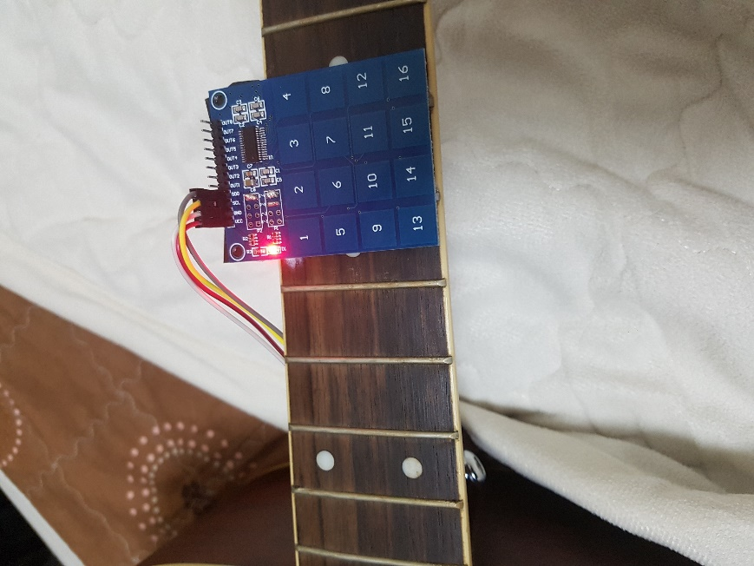
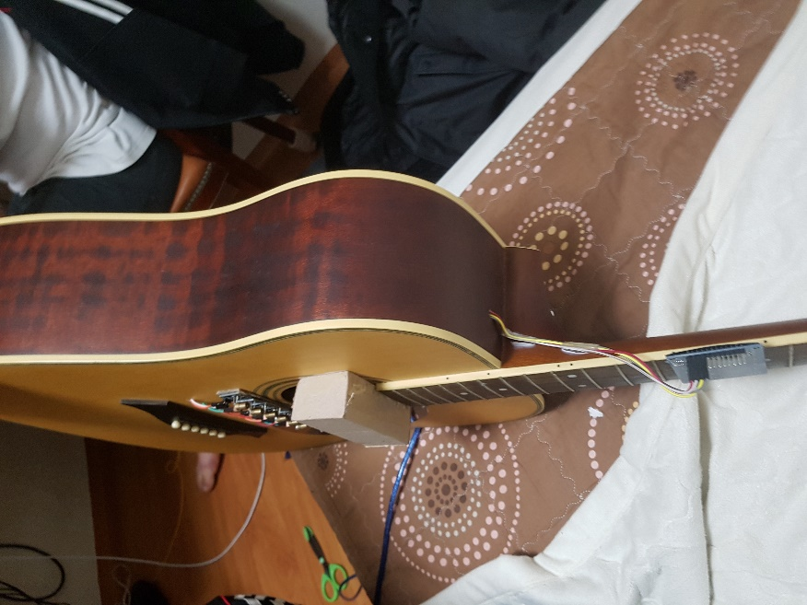
Production process

Slide 12
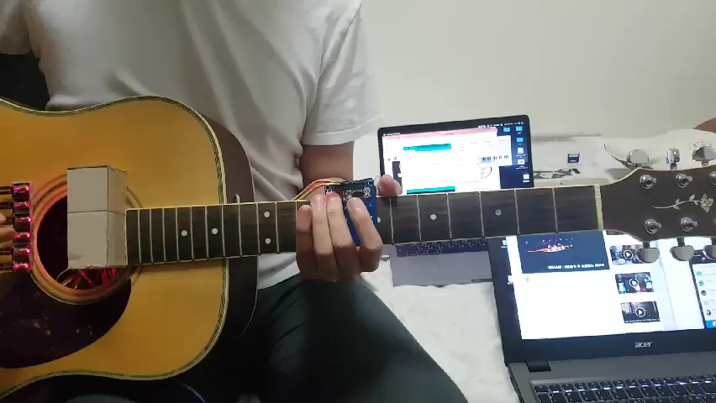
Demo

Slide 13


Team Contribute
Son Min Wook
Jeon Hyung Jin
Assembling Arduino
Circuit Design
Decoration
Arduino Coding
Circuit Design
Decoration

Slide 14
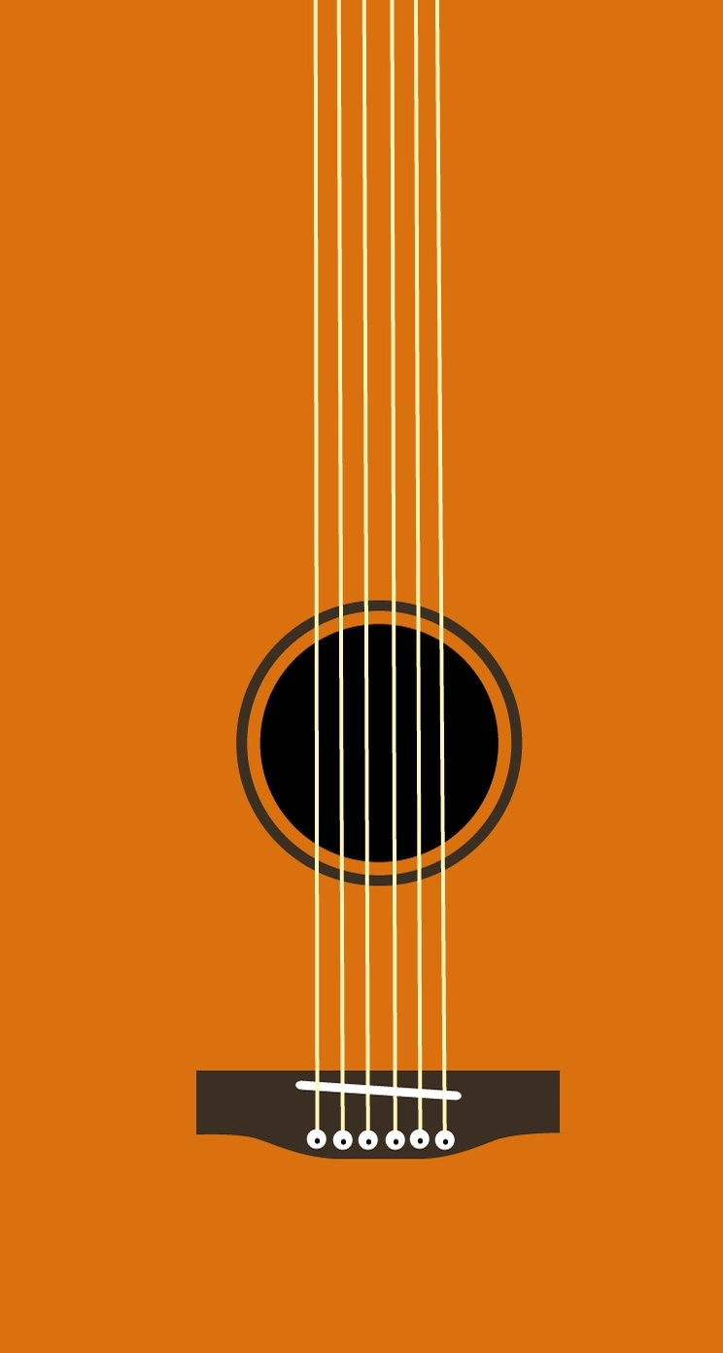
“
Expectation
Beginners and children can use it easily.
Can make various kinds of guitar sounds
and other instruments

Slide 15
Review

Slide 16
Thank You

